Slide 1
Capstone Project
Credit Card Fraud Detection

Slide 2
Agenda
Problem Statement
Solution Methodology
Cost-Benefit Analysis
Conclusion and Recommendation

Slide 3
Problem Statement
Finex is facing the issue of increase in fraudulent transactions made through credit cards/debit cards day by day, and no proper action is being taken when an unauthorized transaction is made.
As Finex is also not equipped with the latest financial technologies, it is becoming difficult for the bank to track the data breaches on time to prevent losses.
Finex wants to identify the possible root causes and action areas to come up with a long-term solution that would help the bank generate high revenue with minimal losses.

Slide 4
Solution Methodology
Read and understand data
Data Cleaning and Data Preparation
Check for Duplicates
Remove insignificant Columns
Create Derived Features
EDA
Label Encoding
Splitting the Dataset into Train and Test set
Handle Class Imbalance
Modelling
Logistic Regression
Decision Tree
Random Forest
Model Validation and Analysis of Different Metrics
Conclusions and Recommendations

Slide 5
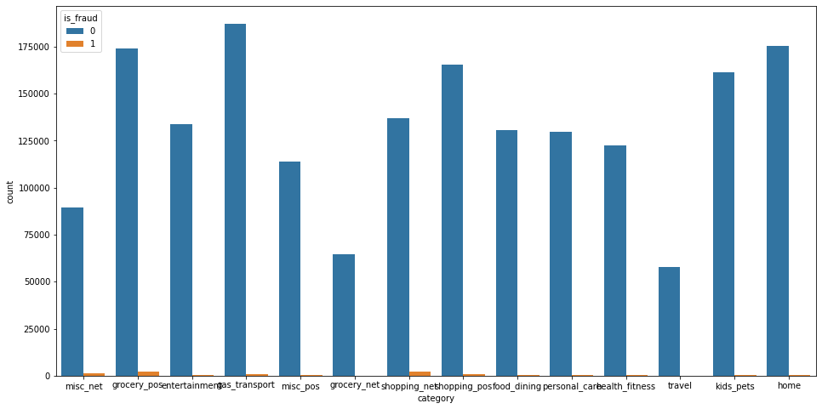
Data Analysis[1/4]
Maximum number of fraudulent transaction occurs in categories like 'grocery_pos', 'shopping_net', 'misc_net', 'shopping_pos', 'gas_transport'.
Minimum number of fraudulent transaction occurs in categories like 'travel', 'grocery_net, 'health_fitness'.

Slide 6
Data Analysis[2/4]
Maximum number of fraudulent transaction occurs for merchants like 'fraud_Kilback LLC', 'fraud_Kozey-Boehm', 'fraud_Rau and Sons'.
Maximum number of fraud happens in 'NY', 'TX', 'PA', 'CA' states and minimum number of fraud happens in 'HI', 'RI' and 'DE' states.
Maximum fraudulent transaction occurs for customers falling in job categories like 'Quantity surveyor', 'Naval architect', 'Materials engineer’.

Slide 7
Data Analysis[3/4]
Similar number of fraudulent transaction happened in both Male and Female.
No fraudulent transactions found in 8 merchants and 19 cities.
Maximum fraudulent transaction occurs for customers falling in job categories like 'Quantity surveyor', 'Naval architect', 'Materials engineer’.

Slide 8
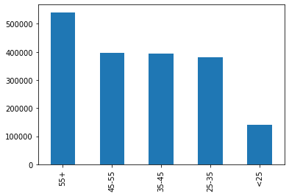
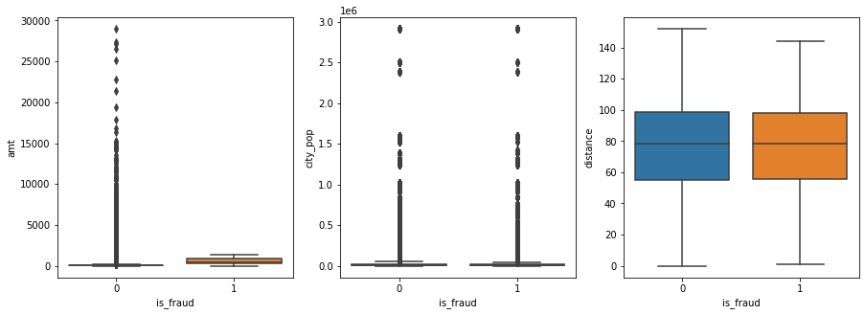
Data Analysis[4/4]
The number of transactions and fraudulent transactions are highest in the age group of '55+'
The number of transactions and fraudulent transactions are highest in the age group of '<25'
Outliers are present in 'amt' and 'city_pop' column.
The mean distance is almost same for both fraudulent and non-fraudulent transactions.

Slide 9
Modelling – Logistic Regression
Train Set
Accuracy: 0.84
F1 score: 0.83
Recall: 0.75
Precision: 0.92
ROC AUC : 0.85
Test Set
Accuracy: 0.93
F1 score: 0.08
Recall: 0.75
Precision: 0.04
ROC AUC : 0.84
Observation:
Accuracy is good in case of test set predictions.
Recall value is almost same in both train and test set.

Slide 10
Modelling – Decision Tree
Train Set
Accuracy: 1.0
F1 score: 1.0
Recall: 1.0
Precision: 1.0
ROC AUC : 1.0
Test Set
Accuracy: 0.99
F1 score: 0.54
Recall: 0.63
Precision: 0.48
ROC AUC : 0.81
Observation:
Training and Test accuracy is good.
Recall value on Test set is around 63%

Slide 11
Modelling – Random Forest
Train Set
Accuracy: 0.99
F1 score: 0.99
Recall: 0.99
Precision: 1.0
ROC AUC : 0.99
Test Set
Accuracy: 0.99
F1 score: 0.59
Recall: 0.59
Precision: 0.58
ROC AUC : 0.79
Observation:
Training and Test accuracy is good.
Recall value on Test set is around 59%

Slide 12
Cost – Benefit Analysis
Cost Benefit Analysis – Part I
S. No | Questions | Answer
a | Average number of transactions per month | 77183.08
b | Average number of fraudulent transaction per month | 402.13
c | Average amount per fraud transaction | 530.66
Cost Benefit Analysis – Part II
S. No | Questions | Answer
1 | Cost incurred per month before the model was deployed (b*c) | 213392.22
2 | Average number of transactions per month detected as fraudulent by the model (TF) | 5363.86
3 | Cost of providing customer executive support per fraudulent transaction detected by the model | 1.50
4 | Total cost of providing customer support per month for fraudulent transactions detected by the model (TF*$1.5) | 8045.79
5 | Average number of transactions per month that are fraudulent but not detected by the model (FN) | 75.86
6 | Cost incurred due to fraudulent transactions left undetected by the model (FN*c) | 40254.46
7 | Cost incurred per month after the model is built and deployed (4+6) | 48300.24
8 | Final savings = Cost incurred before - Cost incurred after(1-7) | 165091.98

Slide 13
Conclusion and Recommendation
Logistic Regression Model holds good to identify the appropriate fraudulent transactions with a recall value of 75%.
After model deployment, yearly cost savings of Finex will be approximately $2Mn.
Finex should deploy the model to achieve long term benefits with increased revenue and lower cost.

Slide 14
THANK YOU

